Slide 1
Weather Analysis
By Devesh Danthara

Slide 2
Objective
The primary objective of this project is to perform an in-depth exploratory data analysis (EDA) of weather patterns across various cities to uncover insights into climatic trends, anomalies, and their potential implications. Specific goals include:
Identifying Weather Anomalies: Detect temperature, wind speed, and other meteorological anomalies and assess their frequency and impact across different geographical regions.
Analyzing City Clusters: Explore and explain clustering patterns of cities based on geographical and weather-related attributes such as latitude, longitude, and climatic factors.
Exploring Coastal City Trends: Investigate the influence of wind speed and direction on weather-related events, particularly in coastal cities prone to extreme conditions.
Understanding Monthly Patterns: Analyze seasonal variations in temperature, humidity, and other factors to identify months with significant deviations or noteworthy weather phenomena.
Supporting Climate Impact Studies: Provide structured insights into how natural factors, such as wind or extreme conditions, may influence weather trends and urban planning.
This analysis aims to guide actionable strategies for disaster preparedness, urban planning, and climate adaptation.

Slide 3
Data Dictionary
BASE TABLES:
City
Description: The name of the city under observation.
Example: 'Vancouver', 'San Francisco', 'Miami'
Latitude
Description: The latitude of the city, indicating its position relative to the equator.
Example: 49.2827 (for Vancouver)
Longitude
Description: The longitude of the city, indicating its position relative to the Prime Meridian.
Example: -123.1216 (for Vancouver)
Temperature
Description: The recorded temperature for the city over time. This can be used to analyze trends, anomalies, and seasonal variations.
Example: 15.2°C, 22.5°C
Humidity
Description: The recorded humidity levels for the city. This is essential for understanding the climate's moisture content and can impact comfort and precipitation.
Example: 65%, 80%
Weather Description
Description: A textual description of the weather conditions such as sunny, rainy, stormy, etc.
Example: 'Rain', 'Clear', 'Thunderstorm'
Wind Speed
Description: The average wind speed recorded for the city. Wind speed is used to understand the potential severity of weather events like storms.
Example: 5.6 m/s, 3.2 m/s
Wind Direction
Description: The average direction from which the wind is blowing. This helps in understanding weather patterns and their influence on the local climate.
Example: 180° (south), 90° (east)
Event Count
Description: The total number of weather-related events such as storms, hurricanes, or tornadoes that occurred in the city over the observed time period.
Example: 10 (for San Francisco), 5 (for Miami)
Datetime
Description: The timestamp indicating when the weather data (temperature, humidity, wind speed, etc.) was recorded.
Example: '2023-05-01 12:00:00'

Slide 4
Data Dictionary
Unpivoted Views
These views are created to reshape the data, allowing for more flexible querying:
humidity_unpivoted
Description: Reshapes the humidity data by unpivoting the city-wise columns into a long format with a 'city' column and a 'humidity' column.
temperature_unpivoted
Description: Reshapes the temperature data by unpivoting the city-wise columns into a long format with a 'city' column and a 'temperature' column.
wind_speed_unpivoted
Description: Reshapes the wind speed data by unpivoting the city-wise columns into a long format with a 'city' column and a 'wind_speed' column.
weather_description_unpivoted
Description: Reshapes the weather description data by unpivoting the city-wise columns into a long format with a 'city' column and a 'weather_description' column.
FORMAT OF QUERY
FOR UNPIVOTING TABLES:
CREATE VIEW (Original table)_unpivoted AS
(
SELECT datetime, 'Vancouver' AS city, Vancouver AS (Attribute_name) FROM (Original table)
UNION ALL
SELECT datetime, 'Portland', Portland FROM (Original table)
UNION ALL
SELECT datetime, 'San Francisco', San Francisco FROM (Original table)
UNION ALL
SELECT datetime, 'Seattle', Seattle FROM (Original table)
-- Repeated for all cities
);

Slide 5
Data Dictionary
Shortened Views
These views aggregate the data to improve query performance:
shortened_humidity
Description: Contains the average humidity values per city, calculated by month.
shortened_temperature
Description: Contains the average temperature values per city, calculated by month.
shortened_wind_speed
Description: Contains the average wind speed values per city, calculated by month.
shortened_wind_direction
Description: Contains the average wind direction values per city, calculated by month.
FORMAT OF QUERY
FOR AGGREGATING TABLES:
CREATE VIEW [shortened_view_name] AS
SELECT
city,
EXTRACT(MONTH FROM datetime) AS month,
AVG([attribute_name]) AS avg_[attribute_name]
FROM
[unpivoted_view_name]
GROUP BY
city, EXTRACT(MONTH FROM datetime);

Slide 6
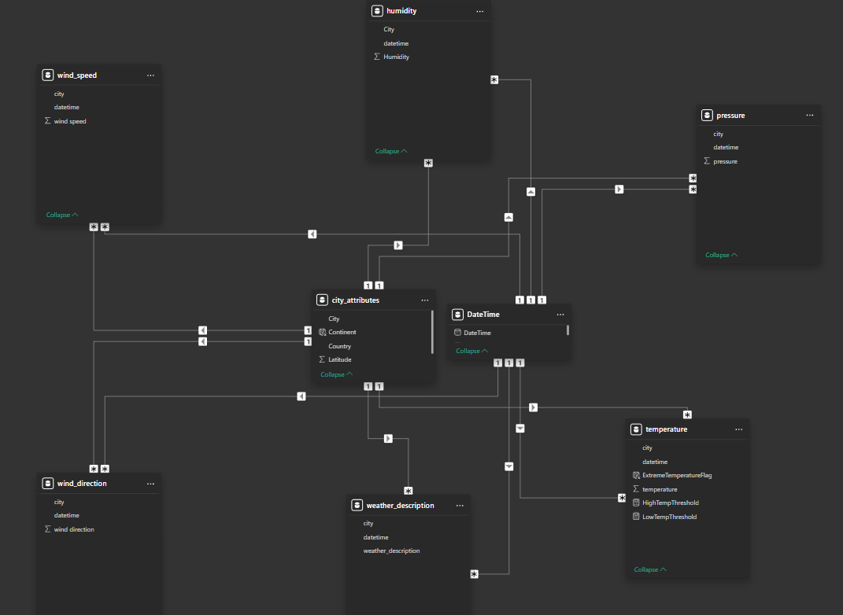
Data Modelling Diagram

Slide 7
PowerBI Problem Statements

Slide 8
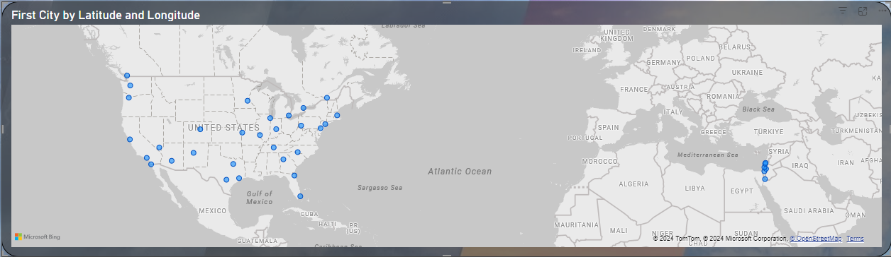
Statement 1: Can you create a geographical map in Power BI showing the distribution of cities in the dataset based on their latitude and longitude?

Slide 9
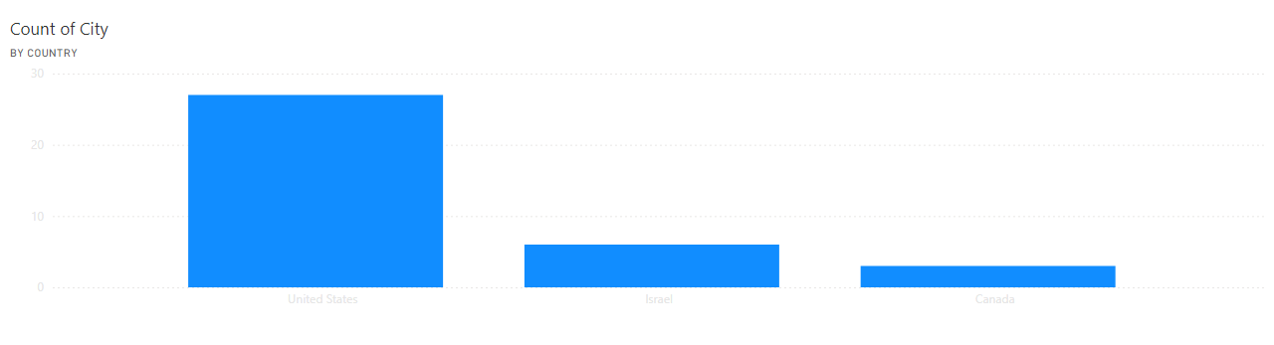
Statement 2: In Power BI, can you create a bar chart representing the top 10 countries with the highest number of cities in the dataset?
Open in Power BI PowerBI solution Data as of 25/11/24, 15:34

Slide 10
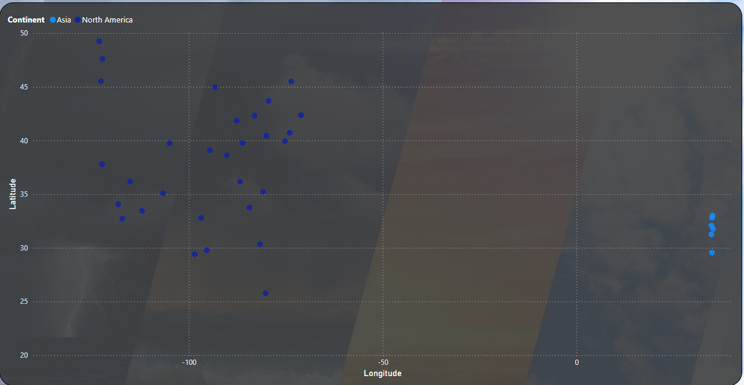
Statement 3: How does the distribution of cities in terms of latitude vary across different continents? Create a scatter plot in Power BI to illustrate this.

Slide 11
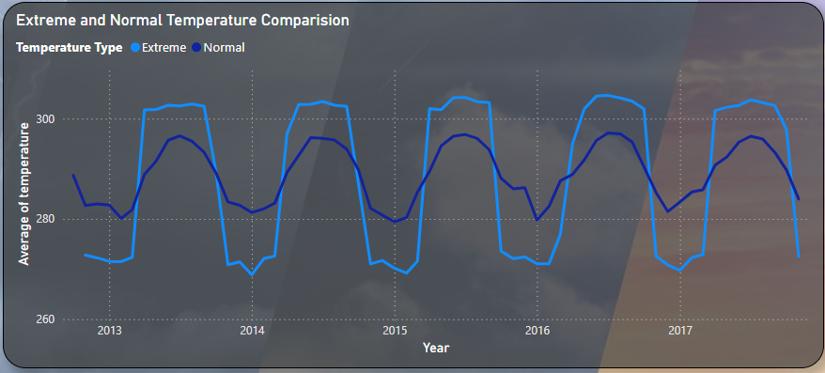
Statement 4: Create a line chart in Power BI to display the temperature trends over time for a selected city. Highlight extreme temperature events.

Slide 12
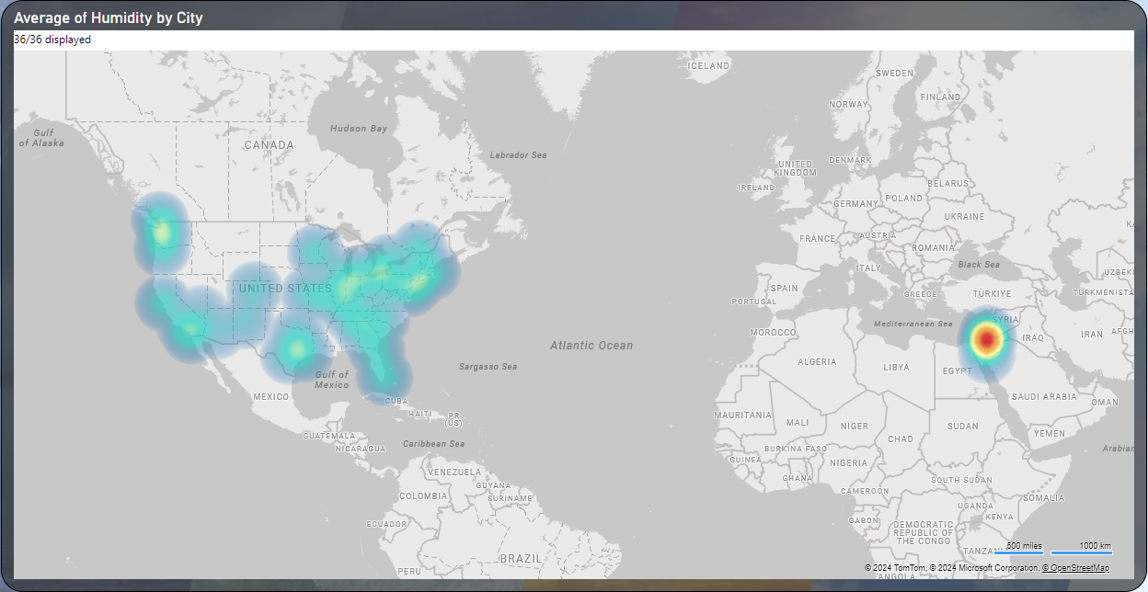
Statement 5: How does humidity vary across different cities? Generate a heatmap in Power BI to visualize this variation.

Slide 13
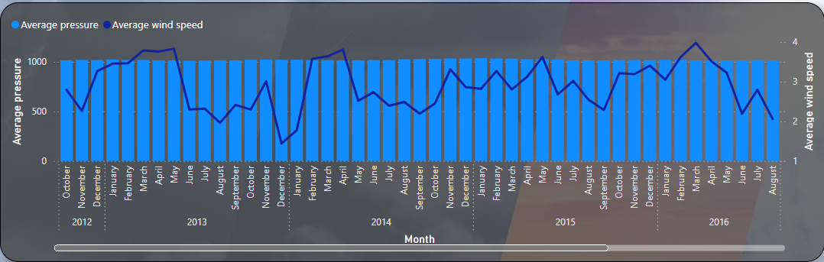
Statement 6: Can you create a time-series chart in Power BI showing the relationship between wind speed and air pressure for a specific city?

Slide 14
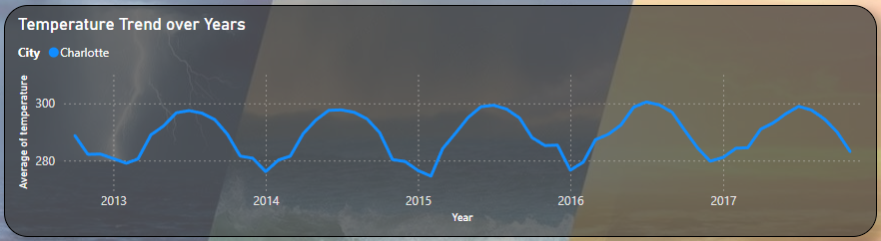
Statement 7: Create a time-series line chart in Power BI to show the overall temperature trends over the entire dataset.

Slide 15
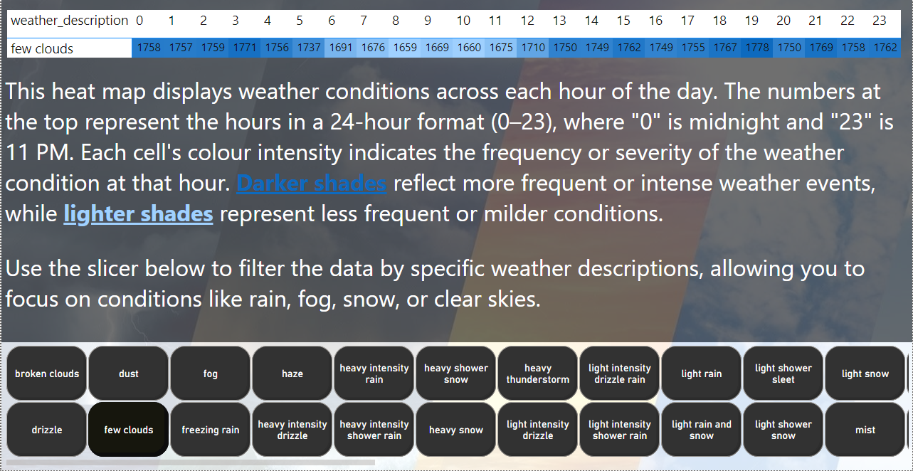
Statement 8: Can you create a heatmap in Power BI to visualize the busiest hours for specific weather conditions (e.g., "clear sky," "rainy")?

Slide 16
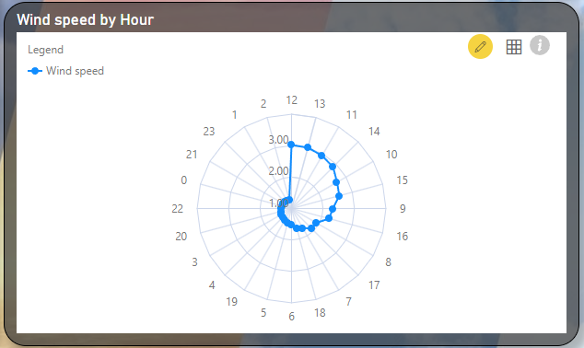
Statement 9: How does the wind speed change over the course of a day? Create a radial chart in Power BI to represent this.

Slide 17
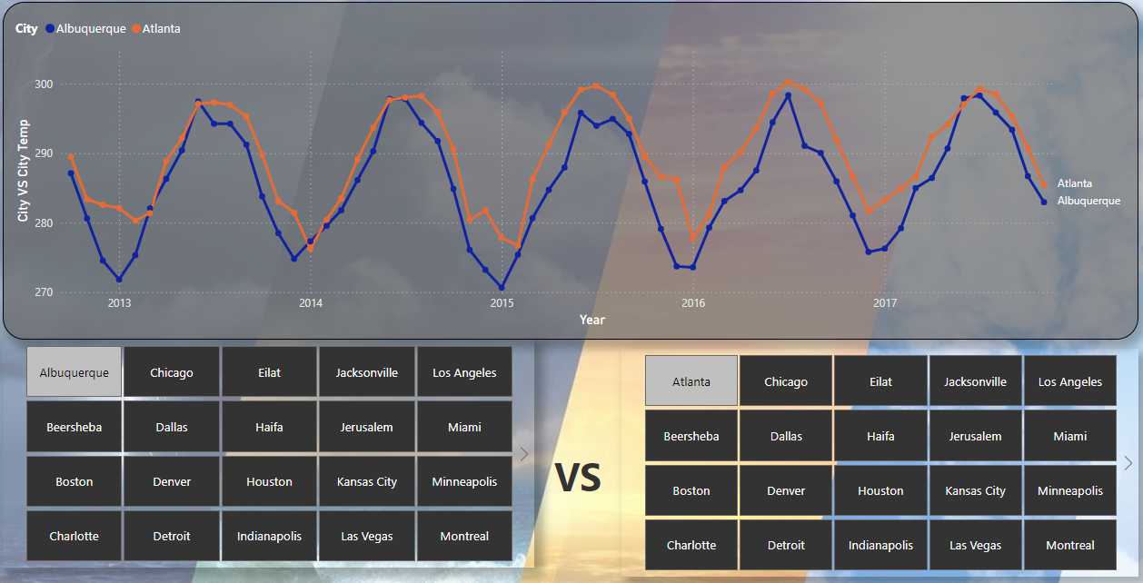
Statement 10: Create a Power BI chart comparing the temperature variations between two selected cities over a specific timeframe.

Slide 18
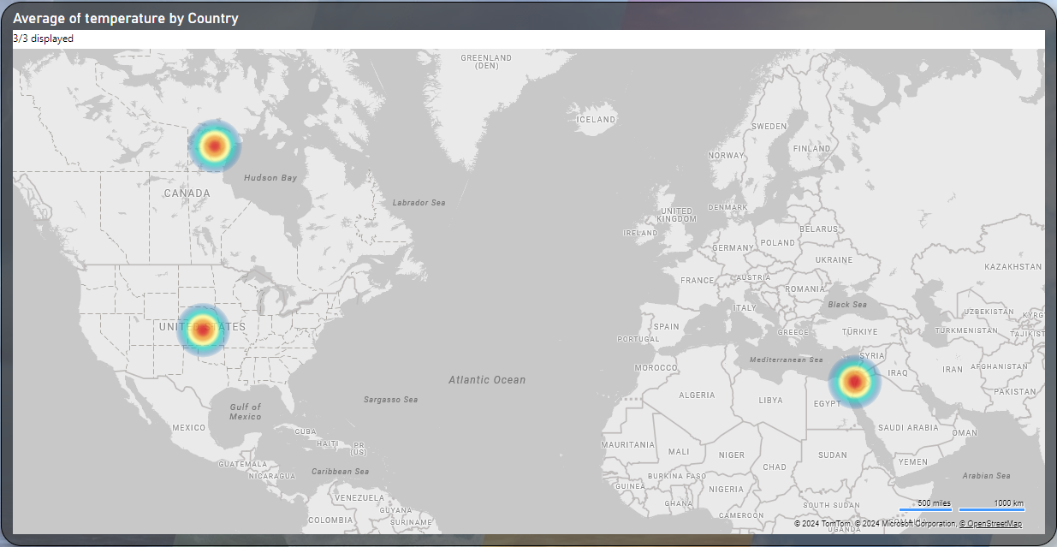
Statement 11: Can you build a heatmap in Power BI to show the temperature ranges for cities across different countries?

Slide 19
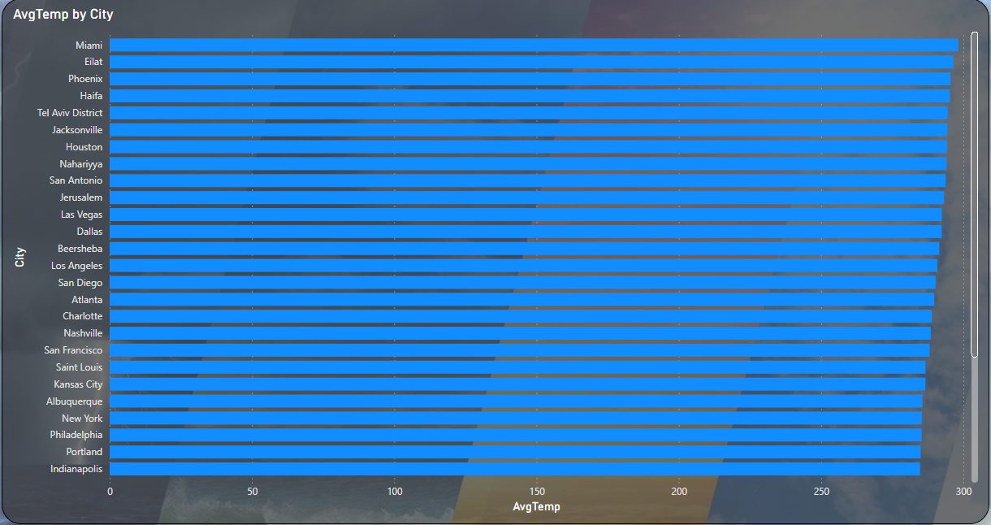
Statement 12: Create a bar chart in Power BI to highlight cities with the highest and lowest average temperatures in the dataset.

Slide 20
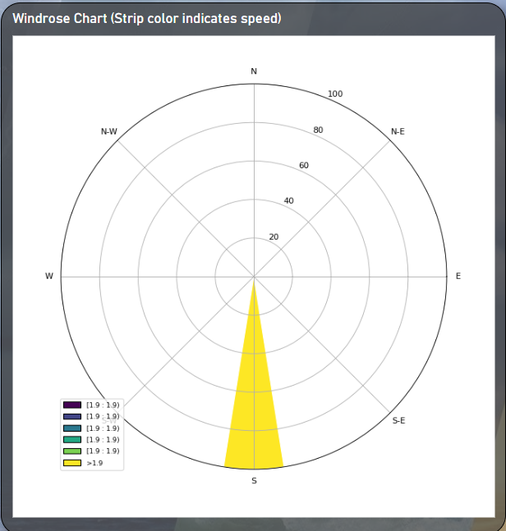
Statement 13: Create a wind rose chart in Power BI to visualize the prevailing wind directions for a selected city.

Slide 21
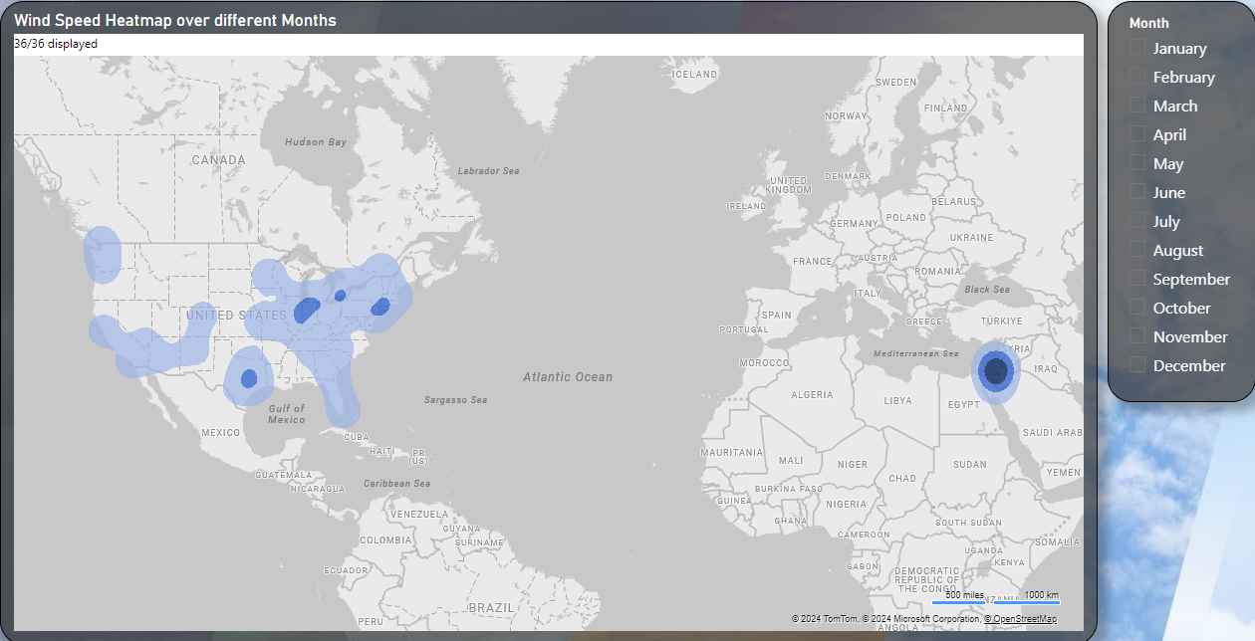
Statement 14: Can you generate a Power BI heatmap illustrating the average wind speeds across cities for different months of the year?

Slide 22
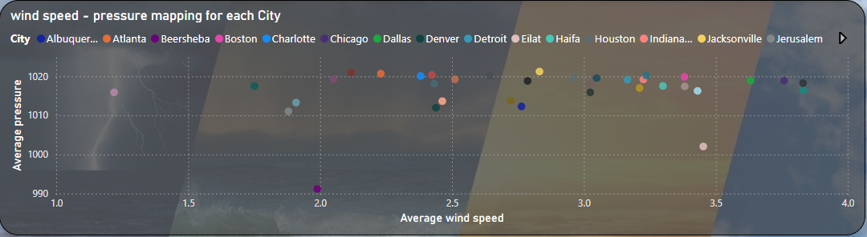
Statement 15: Create a Power BI scatter plot to show the relationship between wind speed and air pressure for a specific city.

Slide 23
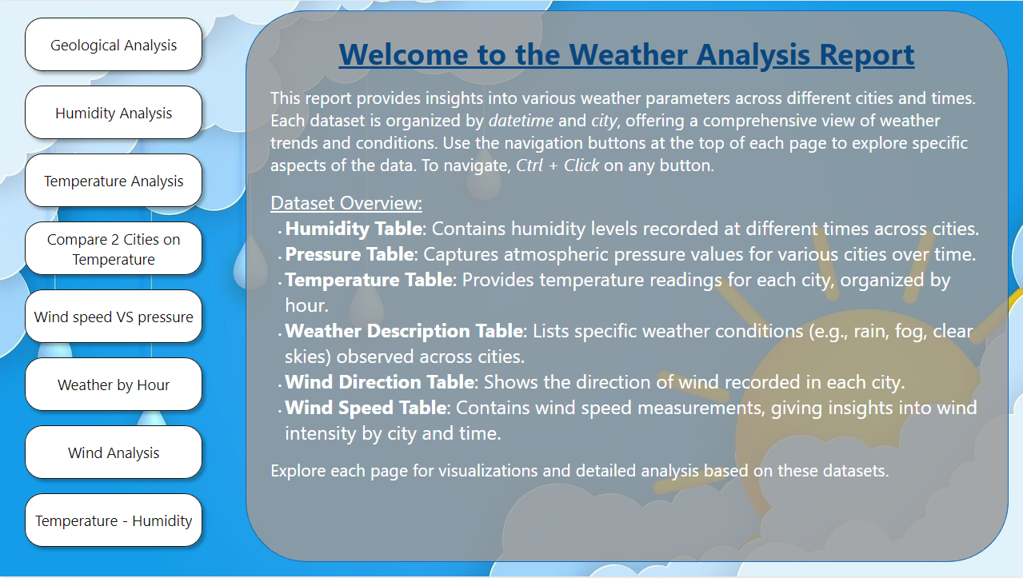
Layout Of the Dashboard

Slide 24
Conclusion
This exploratory data analysis provided valuable insights into weather patterns across multiple cities, examining factors such as temperature, wind speed, humidity, and weather-related events. The analysis highlighted key trends, including the influence of latitude on temperature, the prevalence of extreme weather conditions in certain regions, and the limited local impact of wind speed and direction on severe weather-related events.
Notably, cities with slower wind speeds may experience higher pollution accumulation due to reduced dispersion, while severe weather events often originate far from urban areas, complicating direct correlations with local conditions. These findings underscore the importance of considering broader meteorological contexts when assessing urban weather impacts.
Overall, this analysis contributes to a deeper understanding of city-specific weather dynamics, which can inform urban planning, disaster preparedness, and environmental management strategies.

